Slide 2
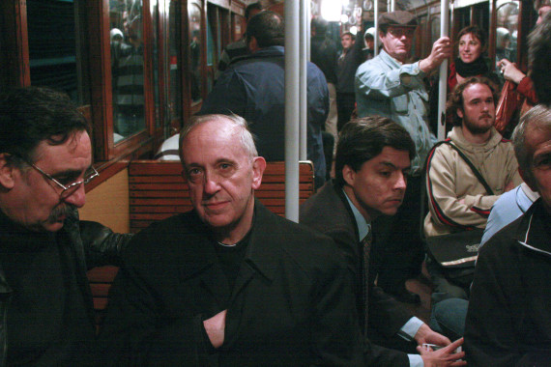
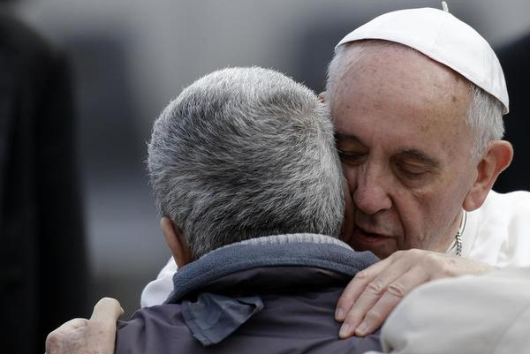
Take a few minutes to read and reflect on the extracts from Pope Francis’ apostolic exhortation, Evangelii Gaudium. What particularly strikes you in these extracts? Share your thoughts with another.
THE CHURCH POPE FRANCIS CALLS US TO BE
Notes:
Distribute the Handout.
Participants are invited to spend some minutes reading and reflecting on the extracts from Pope Francis’ encyclical, Evangelii Gaudium and noting what strikes them.
Participants then break into pairs or threes to share their reflections on the extracts.
Return to the large group and invite key ideas in relation to the Church which Pope Francis desires.

Slide 3
ROLE OF THE LAITY IN THE CHURCH
SCRIPTURE SAYS…
“Therefore go and make disciples of all nations, baptizing them in the name of the Father and of the Son and of the Holy Spirit.” (Mt 28:19)
VATICAN II
emphasized that all Catholics are called to holiness and the mission of spreading Christ’s Gospel.
LUMEN GENTIUM
presented the Catholic Church primarily as part of the whole Christian community of faith, or 'People of God'. Its emphasis, therefore, was on the role of each baptised member of the Church.

Slide 4
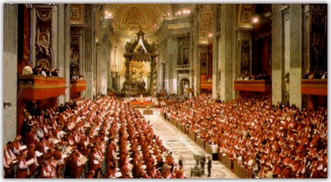
VATICAN II 1962 - 1965
“The call for change from Vatican II had consequences far beyond what had been envisaged and in very different directions. One of those ‘different directions’ or unintended consequences has been the call (in fact the necessity) for lay people to undertake civil and canonical governance roles in education, health and welfare ministries which the religious had built up for the mission of the Church”
(Governing in Faith, Foundations for Formation, Thornber and Gaffney, 2014)

Slide 5
The journey thus far …

Slide 6
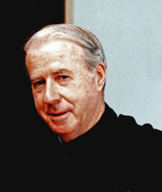
1986 CHAMPAGNAT MOVEMENT OF THE MARIST FAMILY
‘In my visits to the Provinces around the Marist world I often have the privilege of meeting teachers, parents, ex-students, and other friends of the Brothers who are attracted to the spirituality of Father Champagnat and to his sense of mission. This attraction has led some of you to want to commit yourselves to developing the same kind of spirituality and sense of mission in your own daily lives in a regular and organised way. For this reason … the General Chapter of 1985 called for the development of the Champagnat Movement within the wider Marist family’.
Brother Charles Howard,
16 July 1990

Slide 7
2001 TO THE PRESENT…
2001 Statement from the General Chapter
2007 Provincial Chapter, Melbourne
2007 International Mission Assembly, Mendes
2008 Interim Ministry Council, Melbourne
2009 Document: “Gathered around the same table”
2009 XX1 General Chapter

Slide 8
2011 Province Mission Council
2012 Regional meeting of Leaders of Lay Animation (Auckland)
2012 Lay Marist Canonical Task Force
2013 AMC Forum
2014 International gathering to consider forms of association
2014 Invitation to consider joining the Marist Association

Slide 9
The Marist Association is an association
within the church
Other Church institutions, basic commu­nities and small communities, movements, and forms of association are a source of enrichment for the Church, raised up by the Spirit for evan­gelizing different areas and sectors. Frequently they bring a new evangelizing fervour and a new capacity for dialogue with the world whereby the Church is renewed.
But it will prove beneficial for them not to lose contact with the rich real­ity of the local parish and to participate readily in the overall pastoral activity of the particular Church. This kind of integration will prevent them from concentrating only on part of the Gospel or the Church, or becoming nomads without roots.
(Evangelii Gaudium, 29)

Slide 10
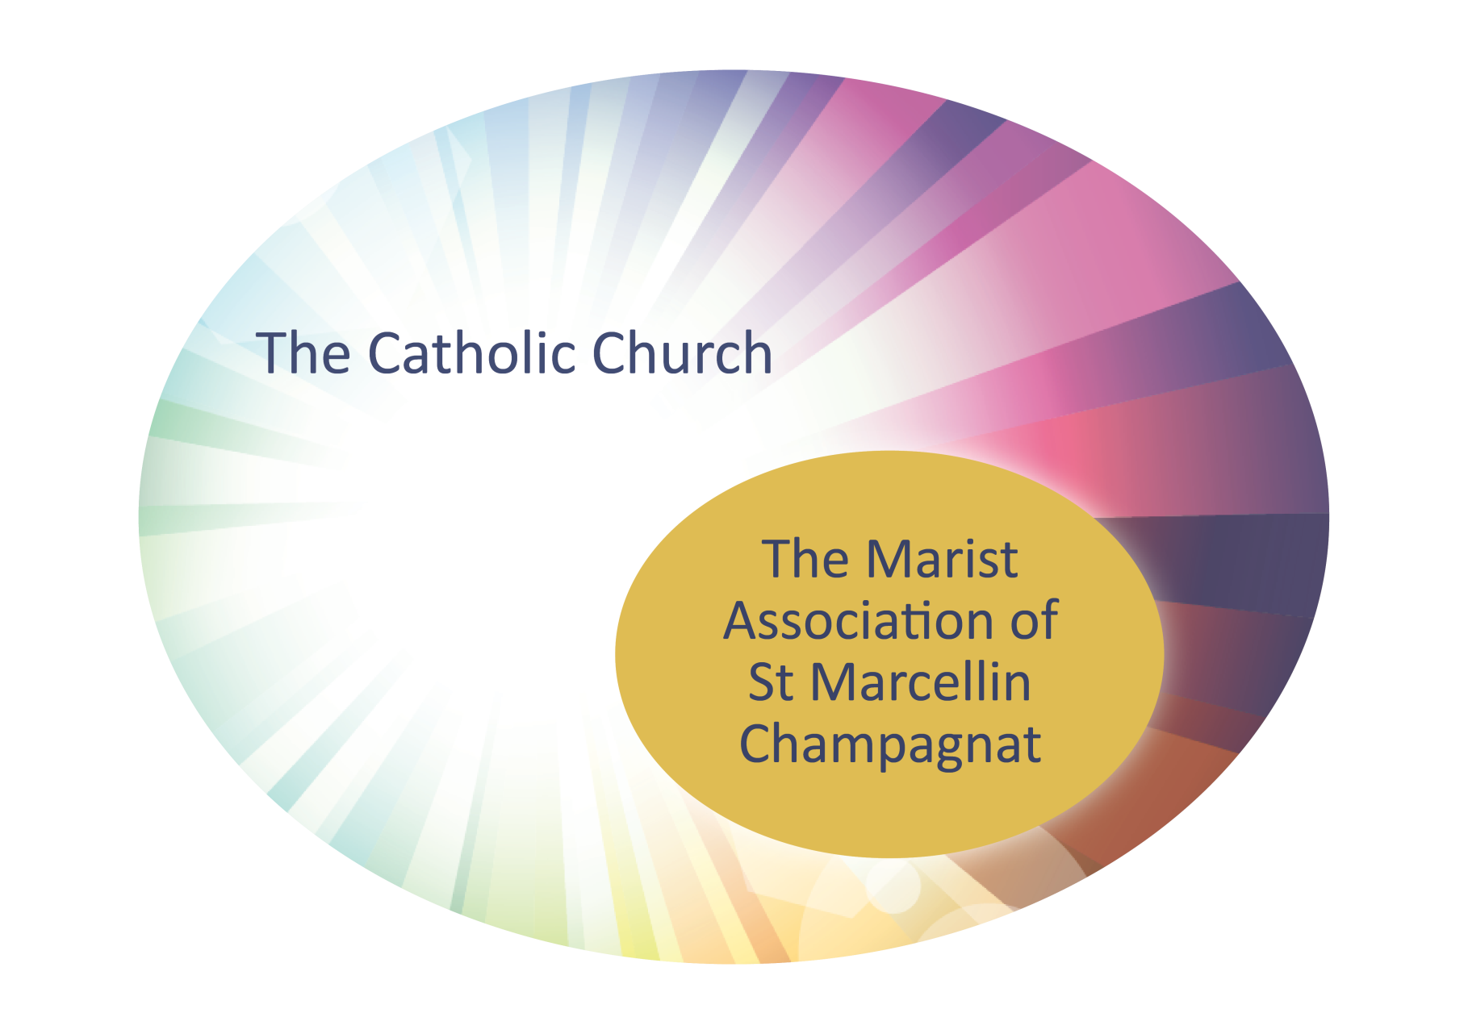
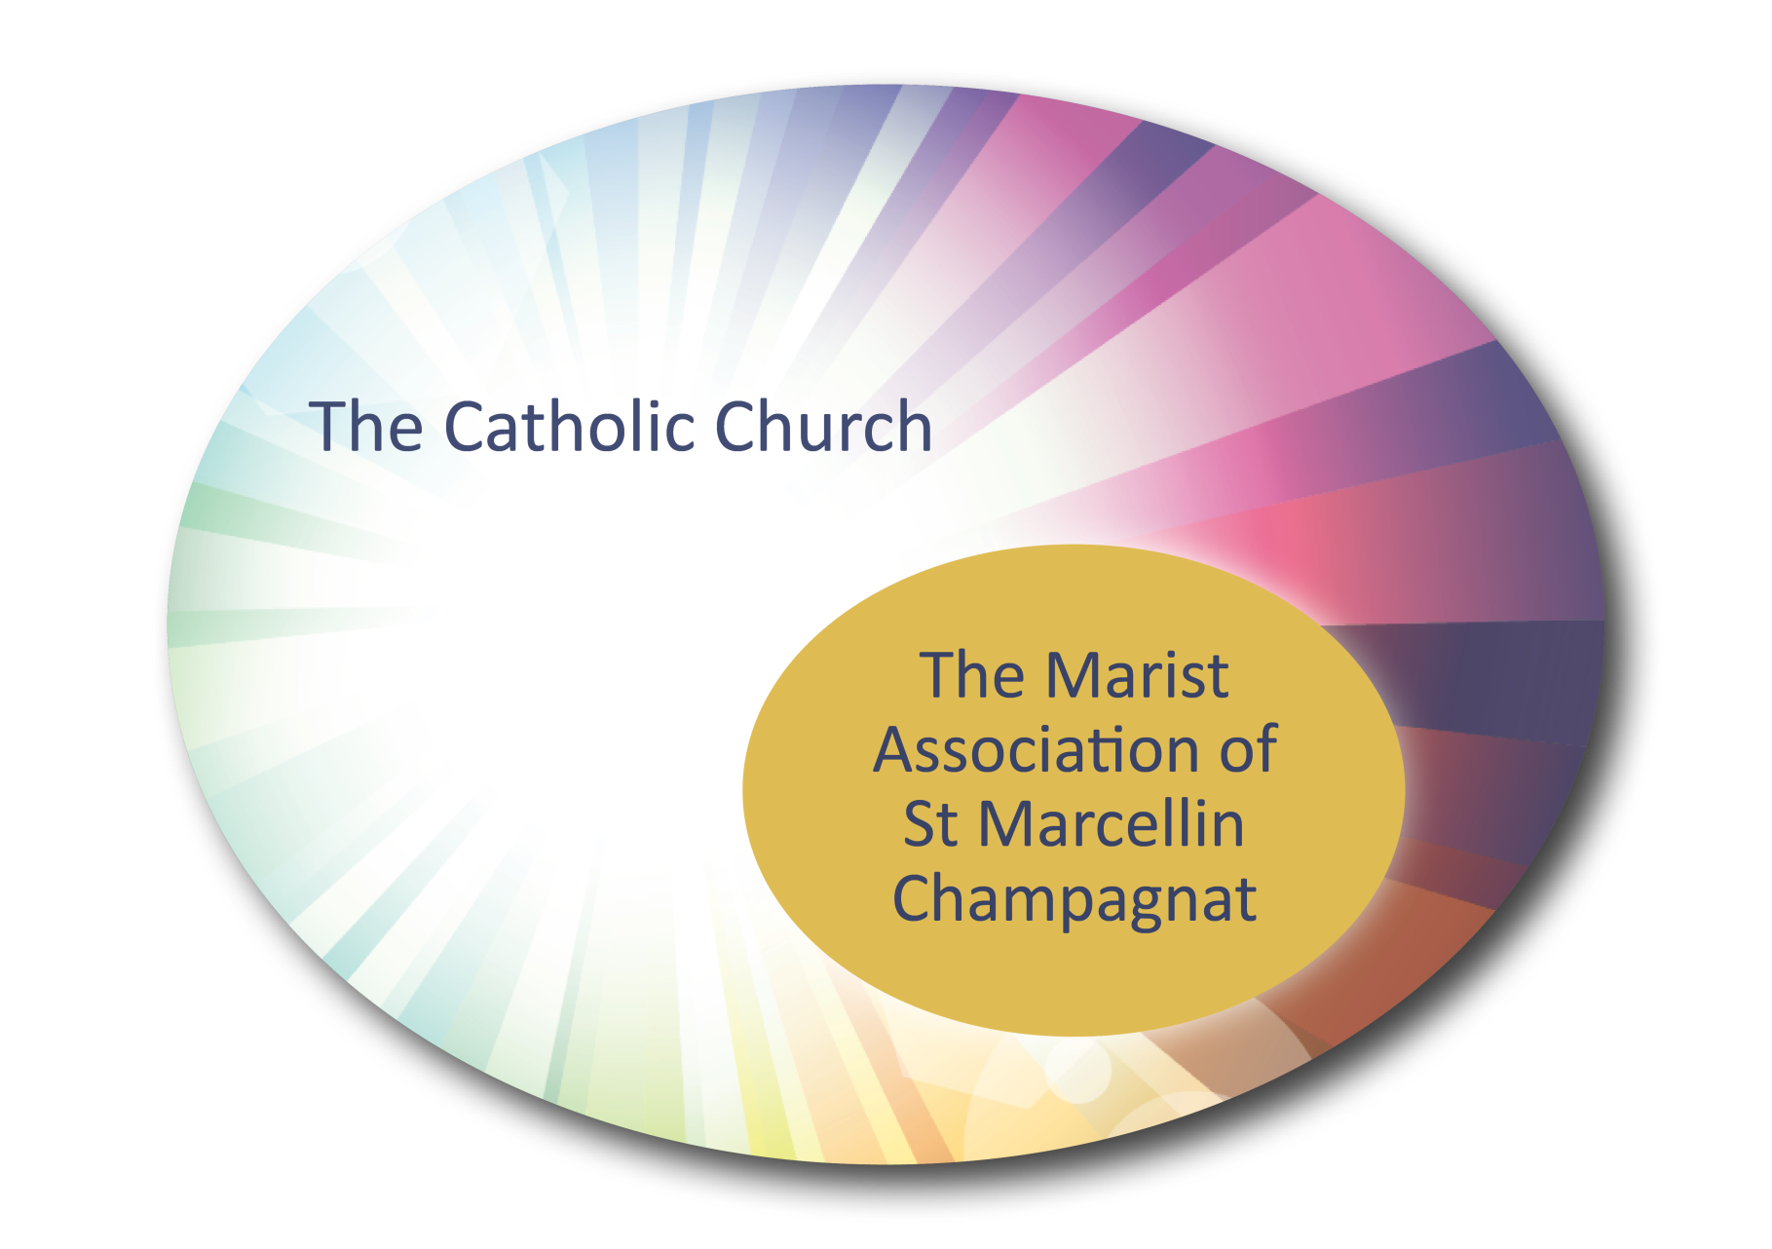

Slide 11
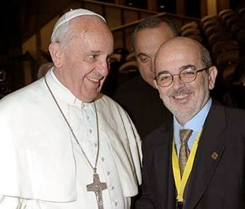
Charisms in the Church
The Holy Spirit also enriches the entire evangelizing Church with different charisms. These gifts are meant to renew and build up the Church. They are not an inheritance, safely se­cured and entrusted to a small group for safe­keeping; rather they are gifts of the Spirit inte­grated into the body of the Church, drawn to the centre which is Christ and then channelled into an evangelizing impulse. A sure sign of the authenticity of a charism is its ecclesial charac­ter, its ability to be integrated harmoniously into the life of God’s holy and faithful people for the good of all.
(extract from Evangelii Gaudium, 130)

Slide 12
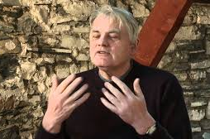
Abbot Mark Patrick Hederman
a monk of Genstal Abbey in Ireland
Abbot Mark Patrick Hederman delivered a short address on the topic “We need to talk about Ireland”.
He speaks about building an imaginative and hopeful future.
It is helpful to apply his comments to the Marist Association …..

Slide 13
How relevant are Abbot Mark’s comments to the Marist Association?
The solution lies in a shared vision for an inclusive future.
Building a platform towards that future requires imagination rather than memory.
The future is what we create together – an invitation to the reality of what we might become. It does not exist until we make it happen.
Share with the person next to you.

Slide 14
How relevant are Abbot Mark’s comments to the Marist Association?
We have a great deal to offer in the area of culture. Culture is something we share generously and magnanimously.
Spirituality is an essential aspect of who we are.
There is no future for us without the guidance of the Holy Spirit.
Share with the person next to you.

Slide 15
Purposes of the Marist Association
From the Constitutions of the Marist Association of Saint Marcellin Champagnat:
The Association provides a spiritual family within the Church for people committed to living the Gospel of Jesus, with Mary as their inspiration, in the style of St Marcellin Champagnat.
The Association seeks to continue the core mission of the Australian Province of making Jesus Christ known and loved, in the way of Mary, to the youth of today.

Slide 16
the Marist Association ICON
The icon of The Ascension by Michael Galovic (2014) is located at the Marist Centre Melbourne.
The icon represents an ecclesiology that recognises the Church’s fundamental Marian principle: that the Disciples of Christ assembled around Mary, the First Disciple, who, like them, is centred on and enlivened by the Risen Christ.

Slide 17
the Marist Association ICON
Flanked by Peter at her right hand and Paul at her left, with John cloaked in Divine red on her far left, and James, the brother of the Lord, holding the Scriptures, the breadth and purpose of ecclesial life is held in unity in Mary. Discipleship and the full reign of Christ on earth and in heaven are the defining elements. Heaven has come to earth and earth has come to heaven.
The Marist Association of Saint Marcellin Champagnat has chosen this icon as its leitmotif. With Marcellin, they look to Mary, sharing in her work of bringing Christ–life to birth in themselves and in young people, and to nurturing the nascent Church as a family of Christ’s disciples.

Slide 18
THE MARIAN FACE OF THE CHURCH
Take a few minutes to read and reflect on the extracts from Pope Francis’ apostolic exhortation, Evangelii Gaudium and Brother Michael Green’s writings.
How does what you have read resonate with you?
Notes:
Distribute the Handout.
Participants are invited to spend some minutes reading and reflecting on the extracts from Pope Francis’ apostolic exhortation, Evangelii Gaudium and from Brother Michael Green’s writings.
????
Participants then break into pairs or threes to share their reflections on the extracts.
Return to the large group and invite key ideas in relation to the Church which Pope Francis desires.

Slide 19
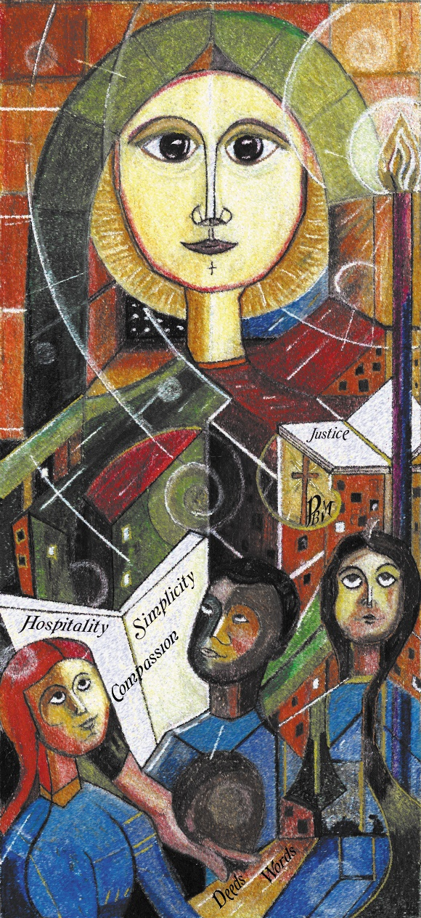
PLEA FOR A MARIAN CHURCH
I would like to plead for a Marian church …
by Francois Marc SM
Notes:
Hand out the Prayer.
Tracey will format this prayer on a separate sheet.

